Slide 1
Summative Assessment: Individual Presentation
Neural Network Models for Object Recognition Using Deep Learning
Student ID:24397

Slide 2
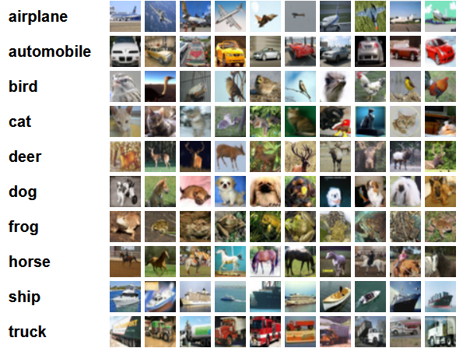

Introduction
Computer vision trains computers to interpret and identify image features.
Project aimed to classify images from the CIFAR-10 dataset using deep learning, specifically CNNs and the pre-trained MobileNetV2.
After the model was trained and tested, evaluation includes accuracy, precision, and confusion matrices were ran.
The CIFAR-10 training images and labels. Source

Slide 3
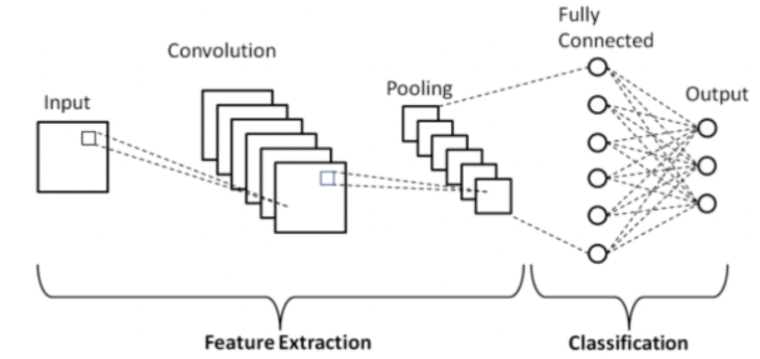
Convolutional Neural Networks
CNNs are a type of deep learning algorithm that make use of multiple layers and convolve filters through images to detect patterns like shapes, edges and textures and generate feature maps.
Research shows that CNNs outperform traditional ML techniques when trained with enough data, which is why this algorithm was chosen for the following assignment.
Simple diagram of the CNN architecture. Source

Slide 4
CIFAR-10 Dataset
Label | Description
0 | airplane
1 | automobile
2 | bird
3 | cat
4 | deer
5 | dog
6 | frog
7 | horse
8 | ship
9 | truck
The CIFAR-10 dataset is multi-class, containing 60,000 color images with a size of 32x32, variably spread across 10 classes.
The initial split after importing directly using KERAS is: 50,000 images for the training set and 10,000 images for the testing set.

Slide 5

Machine learning technique
Modern deep learning approaches often involve using a pre-trained model like VGG16 or MobileNetV2 as a base for the CNN algorithm, saving time and computational costs.
A larger model was initially chosen, VGG16, but the robustness of it made the option very resource consuming, slow and with a tendency for overfitting.
MobileNetV2 is a modern model, shown to have great performance and offering quicker results with less computational efforts. The picture size was also reduced to 96x96 to ease the strain on memory, which proved to be the better option.

Slide 6
Data preprocessing
Loading the dataset with Keras
Normalized pixel values to range 0–1
Resized images to 96x96 for MobileNetV2
Labels one-hot encoded
Further split of the dataset into 80% training and 20% validation
Loss function chosen to be categorical crossnetropy
# Load CIFAR-10 dataset
(x_train, y_train), (x_test, y_test) = tf.keras.datasets.cifar10.load_data()
# Flatten labels
y_train = y_train.flatten()
y_test = y_test.flatten()
# Split into 80% for training and 20% for validation
x_train, x_val, y_train, y_val = train_test_split(
x_train, y_train, test_size = 0.2
)

Slide 7
Model architecture
MobileNetV2 base loaded without final layers, which are frozen for overall performance and to not overload the model.
Custom head: alternative pooling layer → dense layer (256, ReLU activation) → dropout → dense layer (10, softmax activation)
# Building of the model using the MobileNet base
model = tf.keras.models.Sequential([
mobilenet_base,
tf.keras.layers.GlobalAveragePooling2D(),
tf.keras.layers.Dense(dense_units, activation='relu'),
tf.keras.layers.Dropout(0.5),
tf.keras.layers.Dense(classes_num, activation='softmax')
])

Slide 8

Training configuration
Batch sizes: 32, 64
Epochs: 10–25
Dense units: 128 vs. 256
Learning rates: 0.001, 0.0005, 0.0001
Used Adam optimizer with custom learning rates
Compiled with categorical crossentropy
Main metric: accuracy

Slide 9
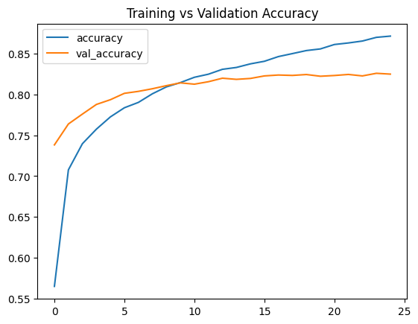
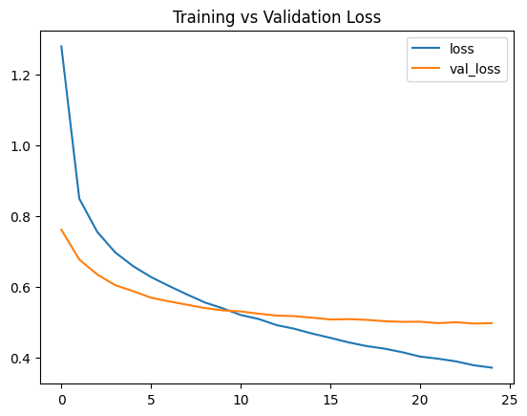
Model training and evaluation
Accuracy/loss tracked to avoid overfitting
Created a comparison of true labels vs predicted
Final evaluation performed on test set
Confusion matrix heatmap generated using Seaborn and Matplotlib

Slide 10
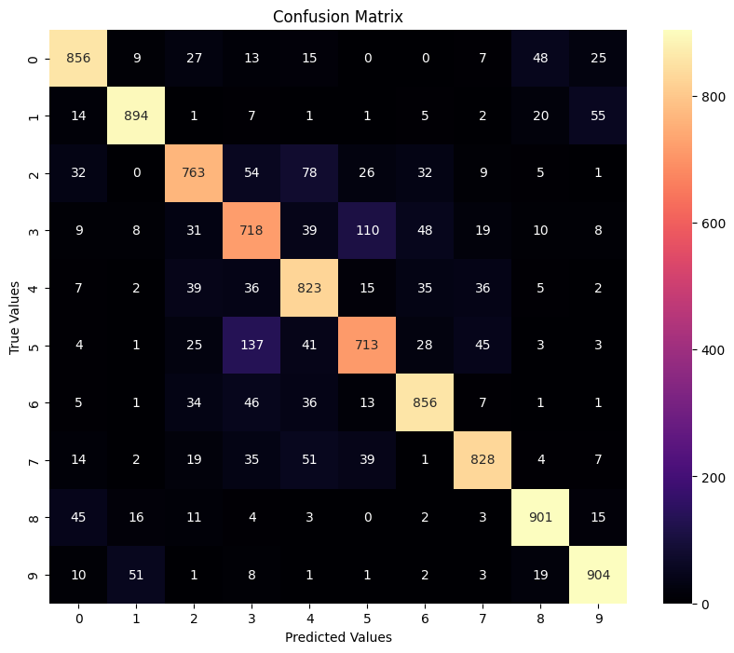
Results and Visualisation
Best model: 82.56% test accuracy with MobileNetV2
Final configuration:
LR = 0.0001
Batches = 64
Epochs = 25
Dense Units = 256
Misclassifications occurred mainly between similar classes

Slide 11
Challenges and Potential Improvements
The initial model, VGG16, caused out-of-memory (OOM) errors due to its high computational demand and 224x224 image size requirement.
Attempted to resolve this using Google Colab with more powerful GPUs, but even then, training was inefficient and unstable.
Ultimately, the solution was to downscale the input images to 96x96 and switch to MobileNetV2, which is faster and more efficient for low-resource environments.
Possible improvements include applying transformations such as rotations, random crops, horizontal flips, or adding noise could enhance data diversity and improve model robustness.
Another potential option are techniques like learning rate decay, which could replace the fixed learning rate to allow the model to converge more effectively.

Slide 12
conclusions
MobileNetV2 | VGG16
82.56% accuracy | 68.88% accuracy
Epochs = 25 Batch size = 64 LR = 0.0001, Dense units = 256 | Epochs = 10 Batch size = 32 LR = 0.001, Dense units = 256
Better than VGG16, faster, perfect for fine-tuning and resource-efficient | Caused out-of-memory errors, tendency of overfitting, slow
Challenge was to create a deep learning CNN model to train CIFAR-10 dataset
More option explored, chose MobileNetV2 which achieved 82% accuracy.
Demonstrated model efficiency despite hardware constraints.
Transfer learning is viable for image classification even with limited resources.

Slide 13
demonstration
A pre-recorded demonstration of the complete model pipeline, with data loading, model prediction, and a small evaluation can be accessed at the following link:
https://drive.google.com/file/d/1YAxSUU8MN-Up8TCcidMpbTYbq4wKQP3s/view?usp=sharing
The video shows the prediction of a single, random test image form the CIFAR-10 dataset, using the trained MobileNetV2 model. A brief visual was created to showcase model performance.

Slide 14
THANK YOU

